Slide 1

Chapter 7
Cloud Computing

Slide 2
IN THIS CHAPTER YOU WILL:
describe key service models and deployment types in cloud computing
relate cloud service and deployment models to practical use cases
explain the basics of GitHub as a collaboration tool and demonstrate the ability to create and explore a GitHub account for managing and sharing code or projects online.

Slide 3
Introduction to Cloud Computing
Cloud computing works through a group of powerful computers (called servers) connected to the internet. These servers store data and run programs for people all over the world. You do not need to install software or buy expensive hardware; you just connect to the cloud and start working.
Example
When you upload photos to Google Drive, they are stored on remote servers (the cloud), not just your phone.
Watching videos on YouTube also uses cloud computing

Slide 4
TIP
When you save a photo, document, or video to a service like Google Drive or Microsoft OneDrive, you are using cloud computing. This technology helps everyone, from schools to businesses to individual users, as it works more quickly, easily, and securely

Slide 5
Cloud Service
Cloud services include:
Storage : saving files online (e.g. Google Drive, OneDrive).
Servers and computing power : running applications or websites on cloud servers.
Software and apps : using complete applications over the internet (e.g. Google Docs, Office 365).

Slide 6
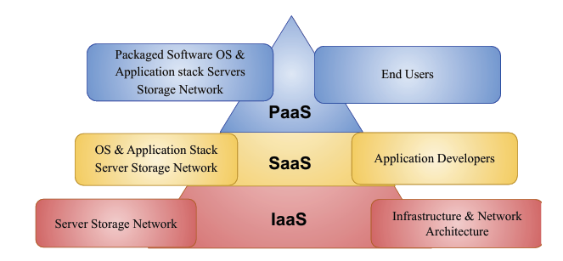
Cloud Service Models
There are three main types of cloud services, and each works in a different way depending on what you need:

Slide 7
Infrastructure as a Service (IaaS)
This is the most flexible and advanced model.
Provides virtual machines, storage, and networks
You control operating systems and applications
Examples
Amazon Web Services
Google Compute Engine

Slide 8
2. Platform as a Service (PaaS)
This is for developers.
Provides a platform to build, test, and run applications
No need to manage hardware or operating systems
Examples
Google App Engine
Microsoft Azure

Slide 9
3. Software as a Service (SaaS)
This is the most basic and user-friendly model.
You use software through the internet
No need to install or maintain anything
Everything is managed by the provider
Examples
Google Docs
Gmail

Slide 10
Benefits of Cloud Services
1. Access Anywhere
You can use your data and applications from any device with internet. 👉 Example: Access files on Google Drive from phone, laptop, or school computer.
2. Cost Saving
No need to buy expensive hardware
Pay only for what you use

Slide 11
3. Storage Capacity
Cloud provides large storage space. 👉 You can store photos, videos, and documents without worrying about device space.
Automatic Updates
Software updates happen automatically
No need to install or maintain manually

Slide 12
Easy Sharing & Collaboration
Share files instantly
Multiple users can work together
Example: Working together on Google Docs in real time.
Backup and Recovery
Data is automatically backed up
Easy to recover if your device is lost or damaged

Slide 13
Limitations of Cloud Services
1. Internet Dependency
Cloud computing needs a stable internet connection.
If the internet is slow or unavailable, you cannot access your data or applications.
2. Security and Privacy Risks
Data is stored online, which can be targeted by hackers.
Sensitive information may be at risk if security is not strong.

Slide 14
3. Technical Issue
Cloud services can sometimes go down due to technical issues.
This can stop work temporarily.
4. Data Loss Risk
Although rare, data can be lost due to system failure, cyberattacks, or human error.

Slide 15
Cloud Deployment Models
Cloud deployment models describe where your cloud runs and who controls it. These are four main cloud development models:
1. Public Cloud
Owned and managed by third-party providers.
Services are available to anyone over the internet.
Example: using apps like Google Drive or Dropbox
Advantages:
Low cost
Easy to use
No maintenance needed
Disadvantages:
Less control
Security concerns

Slide 16
2. Private Cloud
Used by a single organization only.
Can be managed internally or by a third party.
Advantages:
High security
Full control
Disadvantages:
Expensive
Requires maintenance

Slide 17
3. Hybrid Cloud
Combination of public and private cloud.
Allows data and applications to move between both.
Advantages:
Flexible
Better security with cost efficiency
Disadvantages:
Complex to manage

Slide 18
4. Community Cloud
Shared by several organizations with similar needs (e.g., schools, banks).
Advantages:
Cost shared
More secure than public cloud
Disadvantages:
Less flexible
Shared control

Slide 19
GitHub
GitHub is an online platform used by programmers and developers to store, share, and manage their code. It uses a system called Git to track changes in projects, making it easier for people to work together.
GitHub is widely used by professionals, students, and companies around the world to build software and collaborate on digital projects.

Slide 20
Advantages of GitHub
1. It helps track changes in code using version control (Git).
2. It allows teamwork on the same project from different places.
3. It stores files safely online and can be accessed from anywhere.
4. It offers many free, open-source projects to learn from and contribute to.
5. It supports tools that help automate testing and im prove code quality.

Slide 21
Disadvantages of GitHub.
It can be hard to learn for beginners.
Some advanced features may need a paid plan
It requires the internet to access or update projects.
If not careful, users may upload sensitive/private information.
Not suitable for storing large files like videos or non code content.

